Slide 1
Learning Management System
Adnan Rashid, Carolann Mora, Jheysson Menendez, Jesus Lozano, Alex Nino

Slide 2
Overview
The goal of this project is to create a user streamlined learning management system.
Allows students to view their information, classes and grades, as well as register/drop classes.
Faculty members can view their students, upload grades.
Admin can view all students and faculty members, add students or faculty to the program.
Easy to use GUI and all data stored in a SQL table.

Slide 3
Structure
Agile development style.
Group members split in two teams, developer and documenter.
Development team handles SQL, GUI and database execution.
Documentation team handles diagrams, reports and organization.
Developer team – Adnan Rashid, Carolann Mora, Alex Nino.
Documentation team – Jesus Lozano and Jheysson Menendez.

Slide 4
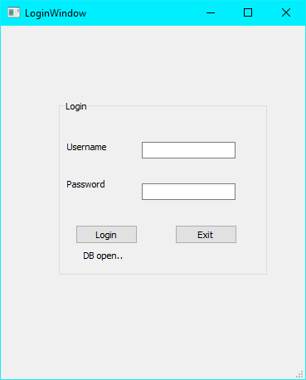
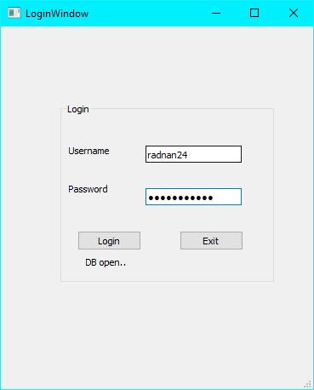
Login Page
Students, Faculty, and the admin login through this window with a stored username and password within the database.
Well proceed as a student with the username= radnan24 and password = Password123.

Slide 5
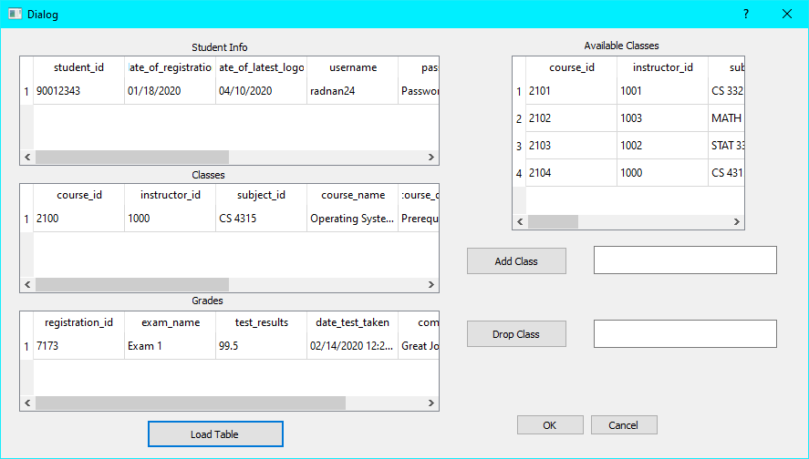
Student Window
After the student logs in and hits the load table button the students information, classes taking, grades, and classes available loads.
The student can then choose from the available classes and add that class to their schedule(this function is still underwork).

Slide 6
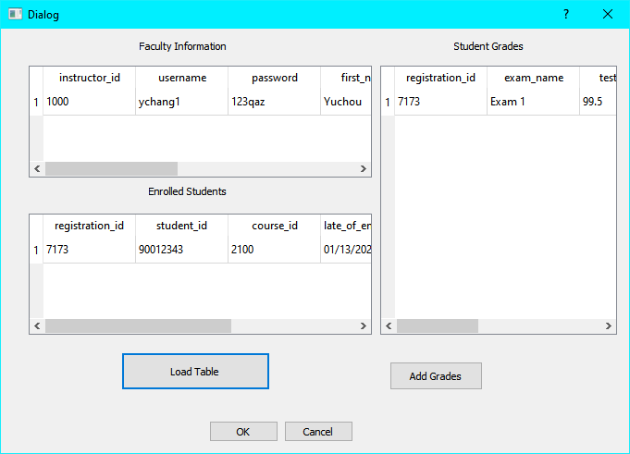
Faculty Window
The faculty member logged in with the username = ychang1 and password = 123qaz.
The faculty window pops up with that faculty members information as well as the students enrolled in their class and the grades.
From here the user can add a grade which will be shown in the next slide.

Slide 7
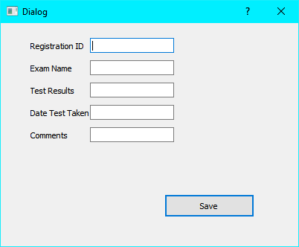
Add Grades
The faculty member just fills in the information requested and then the database is updated.
The registration ID is shown in the previous table and stays open and easy to view in case of many students.
Once the student logs in he/she can see the new grades added.

Slide 8
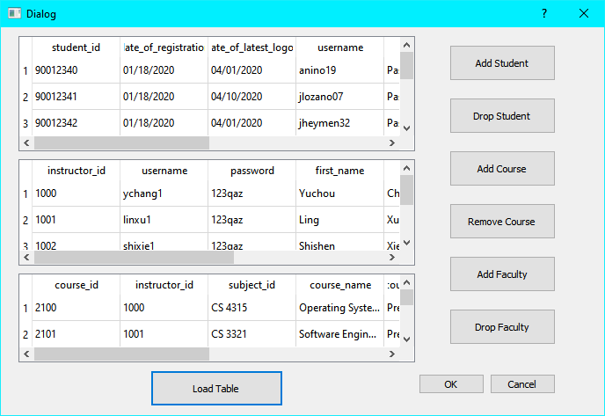
Admin Window
This is the admin window that is accessed with the username = admin1 password = Password123.
It shows all students, faculty, and all classes being offered. From here the admin can add/remove students, add/remove classes, and add/remove faculty members.
Clicking on any of the buttons brings up a second window which will be shown next.

Slide 9
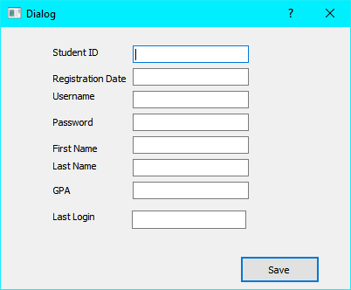
Add student
Fill in the necessary information, and then the database will be updated with that student.
Adding faculty and courses work similarly.
The drop buttons has not been implemented yet and will be in a future update

Slide 10
Future Updates
As with any program things can always be improved.
In a future update we would like to see the database uploaded to an online server so the need for changing the database path would not be necessary.
The buttons that do not work as of now would be fixed and implemented.
A change username and password feature.
A system that allows student and faculty to request information from the admin such as password changes that then is approved by the admin.
A rating system for professors that is generated by the students.
A streamlined adding function where students, and admins can just select a line in the table and add it vs typing everything.

Slide 11
Conclusion
The project was a blast to work on and taught us a lot about communication and how to best structure our time for better efficiency.
Due to COVID we had to best use GitHub as well as group emails between the members to stay on track.
We hope you enjoy our software as much as we enjoyed creating it.
GitHub link - https://github.com/AlexxNino/CS3321_Team_Project

